Slide 1
Mathematics Team
2012
The Use of Math Sprint in a Tutorial Program for
Seventh Grade Students to Improve End of Grade Test Scores
Notes:
去除PPT模板上的--无忧PPT整理发布的文字
首先打开PPT模板，选择视图，然后选择幻灯片母版
然后再在幻灯片母版视图中点击“无忧PPT整理发布”的文字文本框，删除，保存即可
更多PPT模板资源，请访问无忧PPT网站--http://www.51ppt.com.cn
使用时删除本备注即可
将此幻灯片插入到演示文稿中
将此模板作为演示文稿（.ppt 文件）保存到计算机上。
打开将包含该图像幻灯片的演示文稿。
在“幻灯片”选项卡上，将插入点置于将位于该图像幻灯片之前的幻灯片之后。（确保不要选择幻灯片。插入点应位于幻灯片之间。）
在“插入”菜单上，单击“幻灯片（从文件）”。
在“幻灯片搜索器”对话框中，单击“搜索演示文稿”选项卡。
单击“浏览”，找到并选择包含该图像幻灯片的演示文稿，然后单击“打开”。
在“幻灯片（从文件）”对话框中，选择该图像幻灯片。
选中“保留源格式”复选框。如果不选中此复选框，复制的幻灯片将继承在演示文稿中位于它之前的幻灯片的设计。
单击“插入”。
单击“关闭”。

Slide 2
Abstract
A “Math Sprint tutorial model” was used to improve the End of Grade (EOG) test scores on seventh grade students at Elizabeth City Middle School in Elizabeth City, North Carolina. This unique learning technique, developed at Elizabeth City State University, was used during a four-week study group composed of seventh grade students to enhance EOG test scores. The pre-test questions covered topics from the “North Carolina Mathematics Standard Course of Study” which consisted of five competencies: number and operations, measurement, geometry, algebra, and data analysis and probability. The North Carolina Mathematics Standard Course of Study is based on a philosophy of teaching and learning mathematics that is consistent with the current research, exemplary practices, and national standards. A diagnostic exam, corrective instruction, Math Sprints, and a post test were used to assist students with an understanding of seventh grade math. The results of the pre and post exams showed student improvement in understanding seventh grade math.
Key words:
Data analysis and Probability, Measurement, Number and Operations, Geometry, and Algebra, Visual, Auditory and Kinesthetic (VAK)
Notes:
Back to school

Slide 3
Focus Questions
What is the purpose of the EOG?
How do we improve the EOG test scores?
How can we increase students interest in math ?
What is the North Carolina Course of Study?
Solution!
What is the relationship of the Math Sprint to student learning ?

Slide 4
NC Course of Study
North Carolina
Course of Study
5 Competencies of
the NC Course of Study
Purpose
It is the fundamental guide for textbook selections and the foundation of the North Carolina testing program.
Mathematical conceptions
Skills
Procedures
Substantial relationships
Focus on 5 competencies:
Data Analysis and Probability
Measurement
Number and Operations
Geometry
Algebra
Back to
school

Slide 5
North Carolina End of The Grade Test
(EOG)
Purpose
NC Course of Study
3 Goals
Measure student performance on the competencies.
Demonstrate grade level proficiently(grades 3-8)
Scoring: at/above achievement level
Understanding:
Principles
Concepts
Relate mathematical situations
The material on the EOG exam is build off of the North Carolina Course of study and its five competencies.
Assure that students will obtain minimum skills necessary to function as a member in society
Identify strengths/weaknesses
State/local/school levels will be accountable for the results.
Back to
school

Slide 6
Math Sprint
Math Sprint
Design
Purpose
Math sprint is a strategy designed to help middle school students
Students completing problems
State’s Release Items of the previous years’ tests
timed environment
This method uses competition to motivate student learning
Help students develop better learning and cooperative skills
Enhance their knowledge of the subjects presented
Back to
school

Slide 7
NC Course
of Study
Math Sprint
Tutorial Program
Improvement of EOG test scores/ grades
NC Course of Study (Guide)
Math Sprint Tutorial into a Learning Program (Strategy)
Improving EOG test scores and grades (Purpose)
Provides a fun learning environment to keep students interested and excited about math!

Slide 8
Research
Preparation
Tutoring/ teaching
Analyzing Materials
“The North Carolina Mathematics Standard Course of Study”
Mathematical statistical articles: “Reports of Disaggregated State, School System and Performance Data for 2008:
EOG Sixth grade number and percentage (at or above achievement level)
Gender
Ethnicity
Economically disadvantaged/ Not Economically disadvantage
Disabilities

Slide 9
Research
Bloom’s Taxonomy
Goals of the educational process
Divide cognitive objectives into subdivisions ranging from the simplest behavior to the most complex.”
Knowledge
Comprehension
Application
Analysis
Synthesis
Evaluation.

Slide 10
Do students have the same learning style?

Slide 11
Do students have the same learning style?
VAK system (Visual, Auditory, and Kinesthetic (Tactile))
Visual
body language
facial expressions
Auditory
verbal teachings rather than seeing it.
Kinesthetic (Tactile)
hands-on approach. (They also may find it hard to sit for long periods of time.)
Tackle students’ needs

Slide 12
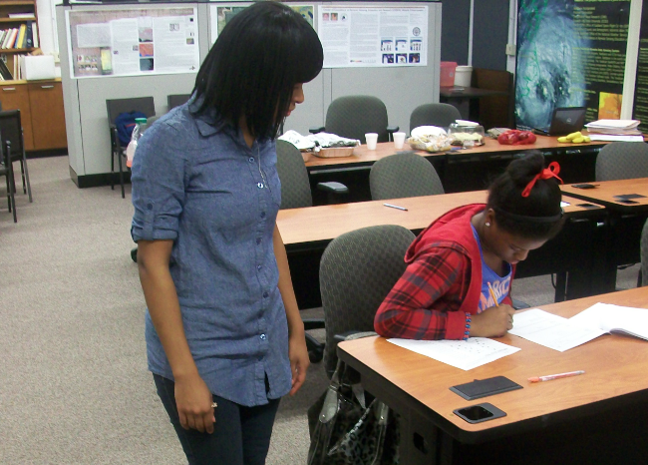
COURSE PLAN OUTLINE
Tuesdays Thursdays from 5-6pm
Four week period
Pre-Test
5 “Goals”:
Data Analysis and Probability
Measurement
Number and Operations
Geometry
Algebra
Math Sprint
Post-Test
Results

Slide 13
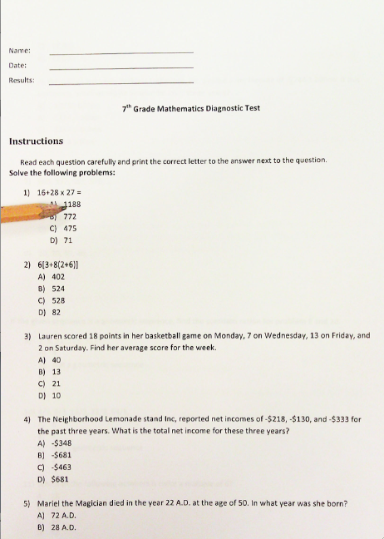
How was the Diagnostic Test Designed?
The five competencies were broken down into “Goals” from the North Carolina Testing Program (EOG Grade 7 Math Sample Items)
The five Goals were divided among team members
Each member was responsible for a “goal” or two
Studied and review the materials of each “goal”
Each member selected 10 questions based on their “goal”
Questions came from former EOG test
A total of 40 questions used for the diagnostic test

Slide 14
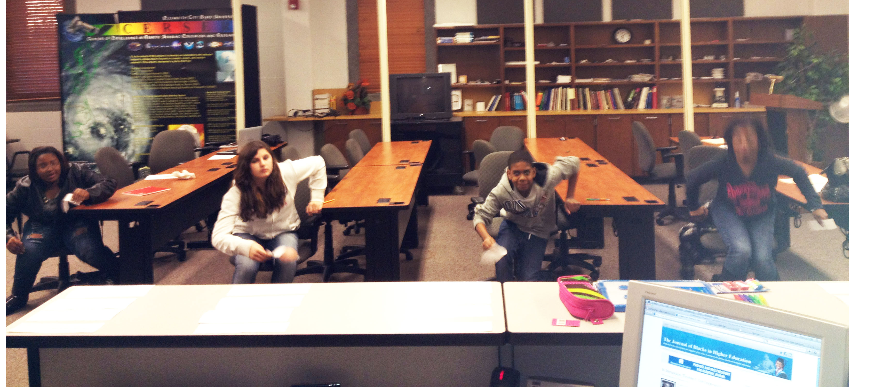
COURSE PLAN: DAILY SESSION ROUTINE
Instructions
Warm ups
Lesson
Hands On Work
A total of 3 math sprints
Worksheets/ math games/ math hunt (prizes)
Food/drinks after every
Session
Tutoring
=
Math Sprint

Slide 15
Student Observations
Learning Styles
Behavior
Work
Methods
Strengths/
Weaknesses

Slide 16
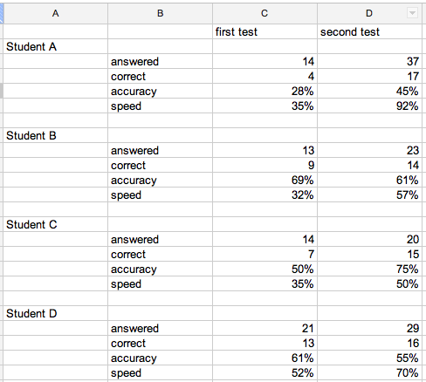
Data/Results

Slide 17
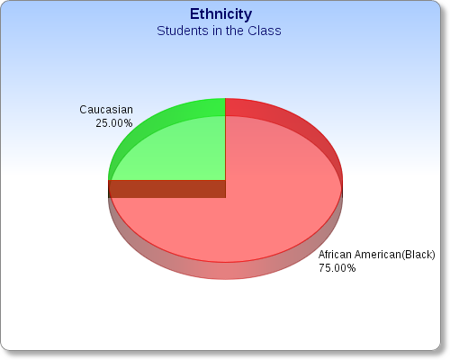
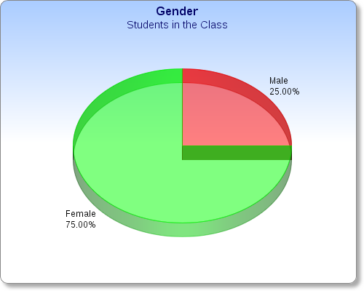
Data/Results

Slide 18
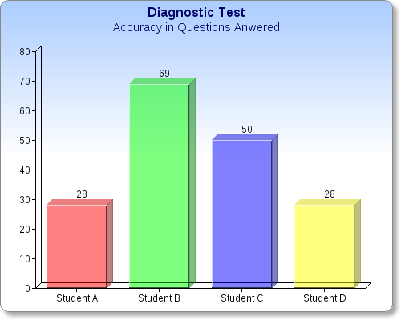
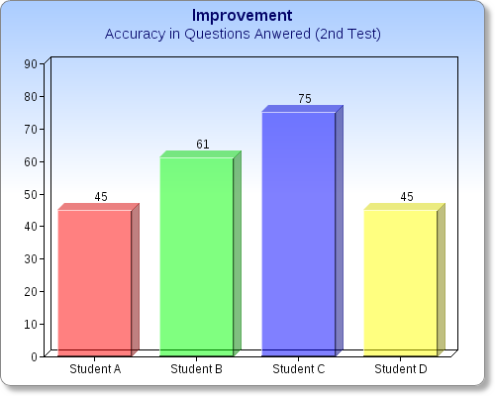
Data/Results

Slide 19
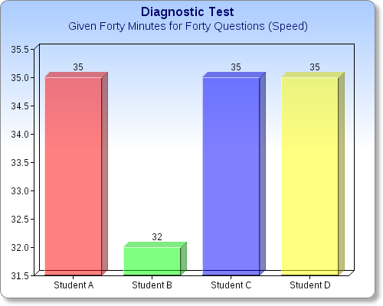
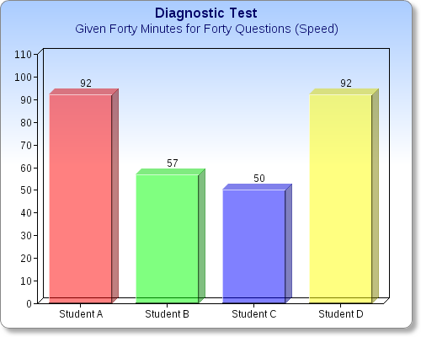
Data/Results

